Slide 1

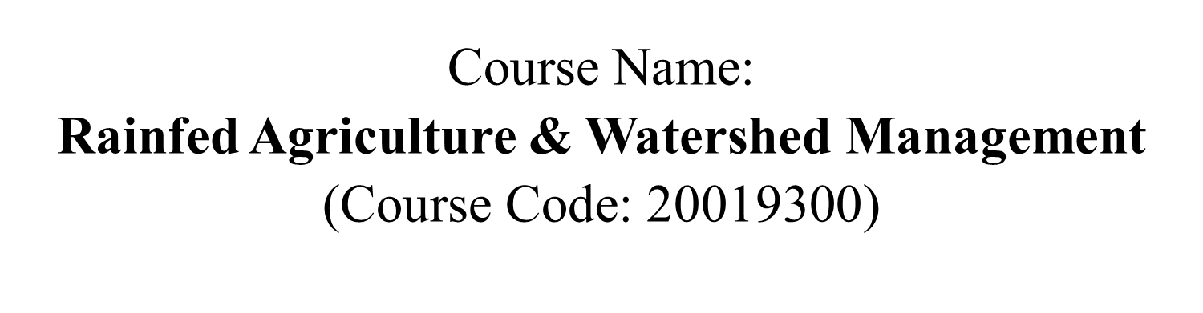
Problems and prospects of rainfed agriculture in India
Delivered by
Mr. ANIL SWAMI
Asst. Professor
Rainfed Agriculture & Watershed Management Mr. ANIL SWAMI

Slide 2
Objective:-
Tell the soil and climatic conditions prevalent in rainfed areas.
Interpret various water harvesting techniques and their efficient utilization.
Apply contingent crop planning for aberrant weather conditions.
Examine the seasonal rainfall and different types of watershed and its components.
Select soil and water conservation techniques to avoid their losses.

Slide 3
Problems for crop production in dry farming regions
Most of the cropping in the arid and semi-arid regions continues to be under rainfed conditions.
A majority of the farmers are small farmers with meagre (Less) resources.
The poor resource base permits only low input subsistence farming with low and unstable crop yields.
The low productivity of agriculture in dry farming regions is due to the cumulative effect of many constraints for crop production.

Slide 4
The problems can be broadly grouped in to
Climatic constraints
Soil constraints
Lack of suitable varieties
Traditional cultivation practices
Heavy weed infestation
Resource constraints
Technological constraints
Socio economic constraints

Slide 5
Climatic constraints
A) Rainfall characteristics: Among the different climatic parameters, rainfall is an important factor influencing the crop production in dry regions

Slide 6
(i) Variable rainfall:
Rainfall varies both in time and space dimension.
Annual rainfall varies greatly from year to year and naturally, its coefficient of variation is very high.
Generally, higher the rainfall less is the coefficient of variation.
In other words, crop failures due to uncertain rains are more frequent in regions with lesser rainfall.
The average annual rainfall of India is 1192 mm where as in Rajasthan it is 580 mm.
Based on the average annual rainfall, the India can be divided into four zones. More than one third of total geographical area in India receives rainfall less than 750 mm.

Slide 7
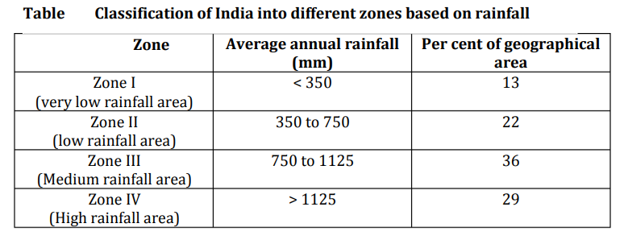

Slide 8
(ii) Intensity and distribution:
In general, more than 50 per cent of total rainfall is usually received in 3 to 5 rainy days.
Such intensive rainfall results in substantial loss of water due to surface runoff.
This process also accelerates soil erosion.
Distribution of rainfall during the crop growing season is more important than total rainfall in dryland agriculture.

Slide 9
iii) Aberrations or variations in monsoon behaviour
(a) Late onset of monsoon:
If the onset of monsoon is delayed, crops/varieties recommended to the region cannot be sown in time.
Delayed sowing lead to uneconomical crop yields.

Slide 10
(b) Early withdrawal of monsoon:
This situation is equally or more dangerous than late onset of monsoon.
Rainy season crops will be subjected to terminal stress leading to poor yields.
Similarly, post-rainy season crops fail due to inadequate available soil moisture, especially during reproductive and maturity phases.

Slide 11
(c) Prolonged dry spells:
Breaks of monsoon for 7-10 days may not be a serious concern.
Break between two consecutive rainfalls for more than 15 days duration especially at critical stages for soil moisture stress, leads to reduction in yield.
Drought due to break in monsoon may adversely affect the crops in shallow soils than in deep soils.
It also has ill-effect on crop yield in tropical and sun-tropical regions.

Slide 12
Others
A) High atmospheric temperature: Because of high atmospheric temperature, the atmospheric demand for moisture increases causing high evapotranspiration losses resulting in moisture stress.
B) Low relative humidity: Low relative humidity results in high ET losses causing moisture stress whenever moisture is limiting.

Slide 13
C) Hot dry winds: Hot dry winds cause desiccation of leaves resulting in moisture stress. High turbulent winds especially during summer months cause soil erosion resulting in dust, storms and loss of fertile soil.
D) High atmospheric water demand: Due to high atmospheric water demand the potential evapotranspiration (PET) exceed the precipitation during most part of the year.

Slide 14
2. Soil Constraints
The different soil groups encountered in dryland areas are black soils, red soils and alluvial soils.
The constraints for crop production are different in different soil groups.
The predominant soil group is alluvial where the problems for crop production are not so acute as in red and black soils.
The different soil constraints for crop production are

Slide 15
a) Inadequate soil moisture availability: The moisture holding capacity of soils in dry regions is low due to shallow depth especially in alfisols (red soils), low rainfall and low organic matter content.
b) Poor organic matter content: The organic matter content in most of the soils under dryland conditions is very low (< 1 %) due to high temperature and low addition of organic manures. Poor organic matter content adversely affects soil physical properties related to moisture storage.

Slide 16
c) Poor soil fertility: Due to low accumulation of organic matter and loss of fertile top soil by-soil erosion, the dry land soils are poor in fertility status. Most of the dry land soils are deficient in nitrogen and zinc.
d) Soil deterioration due to erosion (wind, water): In India nearly 175 m.ha of land is subjected to different land degradations, among them, the soil erosion is very predominant. The erosion causes loss of top fertile soil leaving poor sub soil for crop cultivation.

Slide 17
e) Soil crust problem: In case of red soils, the formation of hard surface. Soil layer hinders the emergence of seedlings, which ultimately affect the plant population. Crusting of soil surface after rainfall reduces infiltration and storage of rainfall, resulting in high run off.
f) Presence of hard layers and deep cracks: Presence of hard layers (pans) in soil and deep cracks affect the crop production especially in case of black soils.

Slide 18
3. Lack of suitable varieties:
Most of the crop varieties available for cultivation in dry lands are meant for irrigated agriculture. There are no any special varieties exclusively meant for dryland areas. Hence still more efforts are required to develop varieties in different crops exclusively meant for dryland agriculture.

Slide 19
4. Traditional Cultivation practices
The existing management practices adopted by the farmers are evolved based on long term experience by the farmers. The traditional management practices are still followed by farmers leading to low yields.
  Ploughing along the slope
  Broadcasting seeds/ sowing behind the country plough leading to poor as well as uneven plant stand

Slide 20
  Monsoon sowing
  Choice of crops based on rainfall
  Application FYM in limited quantity
  Untimely weeding
  Low productive cropping systems
  Inadequate nutrient supply
  Traditional storage system

Slide 21
5. Heavy weed infestation:
This is the most serious problem in dryland areas. Unfortunately, the environment congenial for crop growth is also congenial for weed growth. Weed seeds germinate earlier than crop seeds and try to suppress the crop growth. The weed problem is high in rainfed areas because of continuous rains and acute shortage of labour. The weed suppression in the early stage of crop growth is required to reduce the decrease in crop yields.
Less access to inputs, poor organizational structure for input supply
Non availability of credit in time c) The risk bearing capacity of dryland farmer is very low

Slide 22
6. Resource constraints
  Most of the resource for dry land are run under subsistence level of farming
  There is less intention to adopt new technologies in dry lands among the farmers.
  Occurrence of frequent drought for flood in dry farming areas
  Uncertainty and is distributed rainfall and mid-season break in monsoon leading to crop failure

Slide 23
  Difficulties in adoption of new cropping pattern for cropping systems to suit the monsoon and its behaviour
  Absence of suitable varieties, non-availability of quality seeds, inadequate nutrient supply and problems of soil salinity and alkalinity aggravate the situation in dry farming areas
  Resource poor dry land farmers are not able to practice soil conservation practices and other new technology
  There is a limited recognition of indigenous methods of soil and water conservation
  Poor land preparation and untimely ploughing, sowing, lake of labour and animal power during peak season
  Lack of adequate linkages between crop and animal components in dry farming

Slide 24
7. Technological constraints
  Lack of suitable Technologies for lesser rainfall areas
  Lack of varieties capable of yielding higher in adverse condition. Improved varieties for high yielding varieties are found more vulnerable to moisture stress as compared to traditional variety
  Non-availability of seeds of improved varieties and the demand supply is found to be 80% with groundnut, 50% with Sorghum, 25% with pearl millet and 90% with forest species

Slide 25
  Problems with prediction of sowing rain
  Laser utilization of improved machineries/ implement under dry lands leading to poor timeliness in feel operation and crop failure/ reduced yield
  Poor pest and disease management practices, lack of resources for the purchase, ultimately untimely or delay control measures and lack of water for good quality water for spray in dryland

Slide 26
  Lesser adoption of alternate land use system agroforestry, alley cropping and dry land horticulture in dry farming region
  Inadequate extension activities reading to poor Technologies dissemination

Slide 27
8. Social economic constraints
  Lack of capital, support prices for the produce, marketing facilities and credited proper time make the farmers hesitant to adopt the technology
  Most of the dry land farmers are resource poor which tends them to avoid risk
  Many dry land farmers engage only limited labor , mostly family labor for most of the farm activities
  Prevailing social system in dry regions prevent the farmers in adopting the improved technology
  non-promotion of stakeholder’s concept in development of dry farming

Slide 28
FUTURE PROSPRECTS FOR RAINFED FARMING
A. Research:
Proper agro-meteorological analysis of climate- soil- crop relationship for efficient crop planning and management
As water harvesting systems for crop production is uneconomic including cost of runoff and cost of storage; however, this technique is helpful to stabilize crop production in dry land areas. Therefore, there is a great deal of scope for stabilizing production in dry land areas by adopting water harvesting techniques on community basis.

Slide 29
Review of contingent crop planning for Major three current weather conditions and improvement in the contingent crop planning for different zone mainly to mitigate drought effects.
Importance the development and release of dual conditions high yielding varieties of food and vegetable crops for normal monsoon season and for dryland conditions. Availability of seeds of these varieties along with the suitable agronomic practices will certainly improve and stabilize the production and productivity of rainfed areas.

Slide 30
Identification of improved soil and moisture conservation practices and turn off management suited to the conditions of individual farm holding as well as the watershed as a whole.
Emphasis to increase intensity of cropping by developing appropriate inter-cropping and double cropping systems with importance on pulses and oilseeds.

Slide 31
Agro-techniques on socially acceptable cropping systems (viz; laser leveling, application of organic manures, modified method of sowing i.e. Aqua-fertilizer drill and Furrow Irrigated Raised Bed system of seed bed preparation) bases are to be developed with a view to increase the FUE/WUE, efficient weed management, tillage system and crop residue management including INM.
Emphasis on site-specific research mainly to optimise the use of resources available for conservation and utilisation of moisture under rainfed conditions.

Slide 32
Proper adoption of alternate land use system including Agro-forestry, Agro-horticulture and fodder based cropping system in terms of diversification in cropping system is required for saving water and for efficient water management.
Completion of incomplete major and minor projects and covering about 69 m ha. cultivated under micro irrigations by 2030 is to be exercised.

Slide 33
B. Policy:
  Undertake significant shift in investment from irrigated to rainfed areas, with a major emphasis on afforestation and soil conservation project organised on a watershed basis.
  Investment in soil conservation practices including creation of infrastructure as well as water harvesting system such as farm ponds has to be undertaken on a village-by village basis.

Slide 34
  Weather aberrations continue to plague dry land farmers. Since seed is the primary input in the adoption of improved farm technologies, seed bank must be established with Government support in order to help farmers adopt contingent strategies.
  Draft power is a serious constraint in dry land farming. Individual farmer cannot afford to purchase mechanical implements. In this case, a system of custom hiring in the villages would help farmer to complete their operation timely at an affordable cost.

Slide 35
  High risk is involved in rainfed farming which does not allow farmers to adopt improved crop production technologies. Therefore, availability of crop insurance for drought protection involving selected dry land crops should be implemented.
  Since farm holdings are small and excessively fragmented, further division of land should be prevented. This can be done by encouraging the development of small scale, agro-based industries and services in the rainfed region

Slide 36
  In addition to low productivity in rainfed areas there is also an acute scarcity of fodder. Silvi -pastoral systems on marginal land should be encouraged through liberal financing, and should be established to cope with scarcity during drought years.

Slide 37
Thank You
Rainfed Agriculture & Watershed Management Mr. ANIL SWAMI

